Slide 1

TINKERCAD
4 LED blink Tutorial
BESTIN AUTOMATION
An ISO 9001:2015 certified company
Proprietor: Amritpal Singh

Slide 2


Getting started with Tinkercad Circuits
Step 1: Go to: https://www.tinkercad.com/joinclass
Step 2: Enter the class code.
Step 3: Click on Join with Nickname and enter the nickname.

Slide 3

Step 4: Go to “Classes” section under your name.

Slide 4

Step 5: Enter your class.

Slide 5
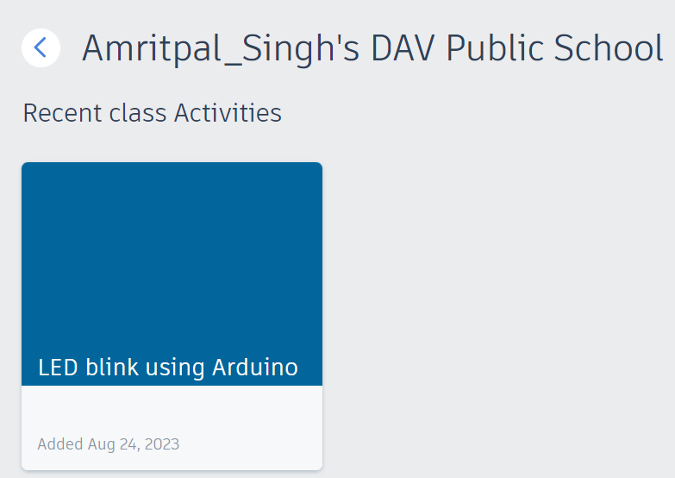
Step 6:Select your activity.

Slide 6

Step 7: Select Circuits
and then click on Create new design
2
1

Slide 7
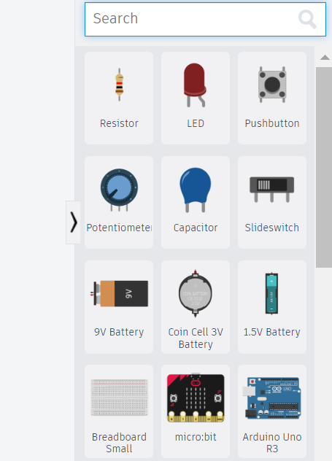
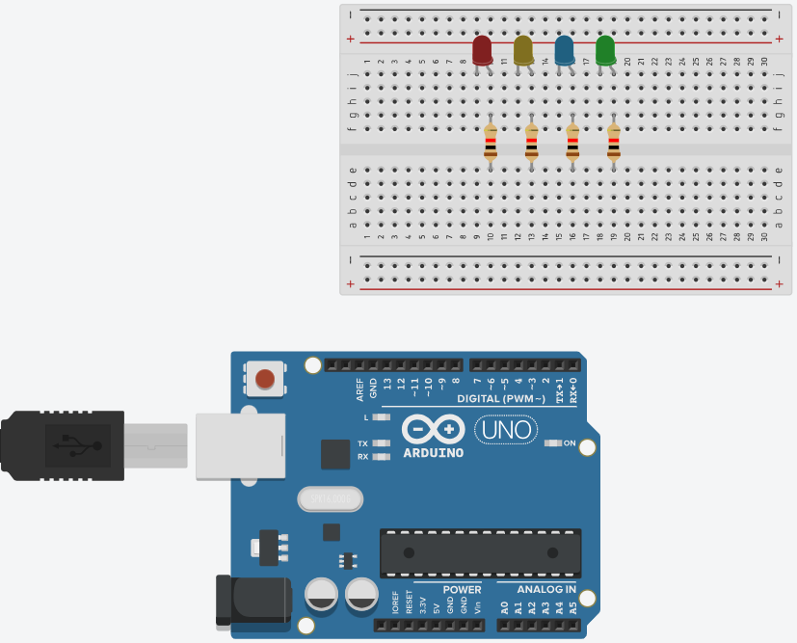
Adding the components
Search and place these components one by one
Arduino
Breadboard
LED x 4
Resistor
4
3
2
1

Slide 8
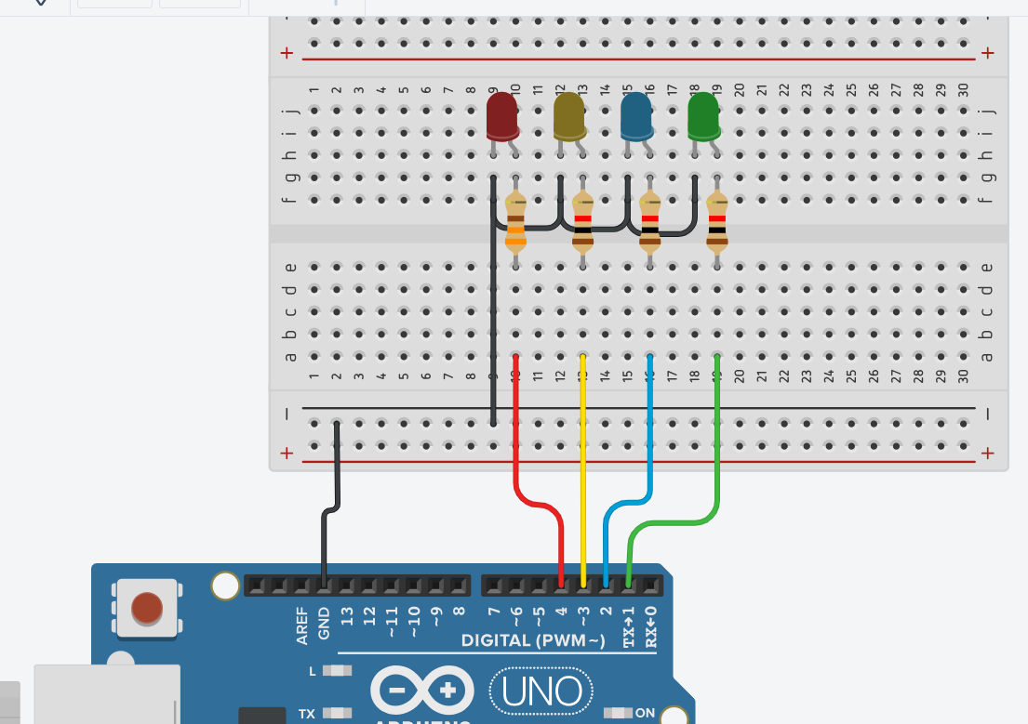
Wiring
Common the cathode of all LED’s to GND of Arduino.
Connect the anode of all LED’s to the Arduino pins respectively.

Slide 9
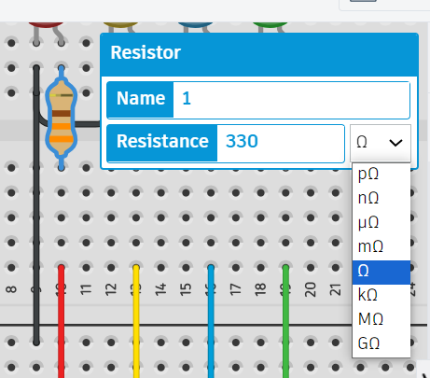
Wiring
Change the resistor value to 330 ohms value by clicking on resistor.

Slide 10
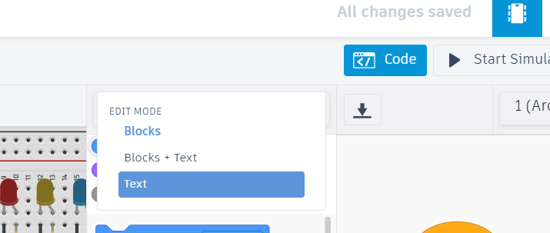
Coding…
Select Text mode from top right corner and click continue.

Slide 11
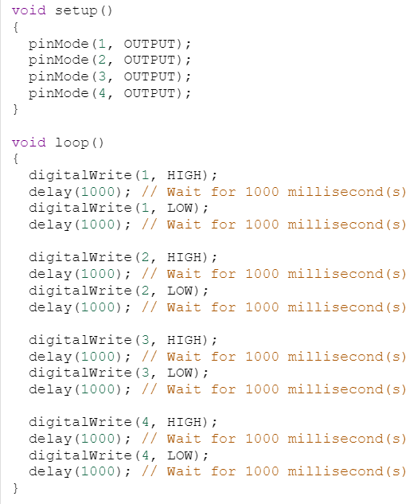
Your main Code

Slide 12

Explanation of code
Set Pin number
Set pin ON/OFF
HIGH means ON LOW means OFF
digitalWrite is a command to turn ON or OFF a particular pin
Delay means wait time
1000ms = 1 seconds

Slide 13
Happy Coding
Journey begins from here……

Slide 14
Thanks for your attention !
BESTIN AUTOMATION
An ISO 9001:2015 certified company

